Slide 1
Intelligent Question Answering System
Rakesh Reddy Pallepati-20
Sandeep Pabolu-19,
Sarat Chandra Varma-14,
Lava Kumar Surparaju-27.

Slide 2
What is Question Answering?
Type of information retrieval. Given a collection of documents ,the system should be able to retrieve answers to questions posed in natural language.
-Wikipedia

Slide 3
Motivation
The scope to ask a question in one’s own way is what moves us forward.
The main requirement is not to get related pages but the exact answer.
This system has its cover everywhere science, education, assistants, etc. This makes it the most important issue where ever a computer has an application.
So, working on the question answering system is worth exploring.

Slide 4
Objective
The project aims in developing a code which has the ability to generate the answers for the questions given by the user.
The answer data is searched through a specific data set.
There by reducing the user’s wait time and simultaneously decreasing the wait time.

Slide 5
Advantages:
User interaction with the data base.
1
Access to previously searched answers.
2
Sentiment analysis for understanding user’s choice.
3
Proper usage of linguistic resources.
4

Slide 6
Implementation
NLP for tokenization, lemmatization, POS tagging, NER, Co-referencing.
Processing data set using core NLP.
Processed data stored in different text files.
Using TF-IDF in combination with the Word2Vec for determining the prominent words.
Then using the OpenIE, WordNet, Clusterring and classification techniques to enrich data set and answering system.

Slide 7
Languages & Tools used:
Java
Protege
Scala
Owl Ontology
Intellij
Spark

Slide 8
Concerns and issues
Data processing for some set of questions.
Stop words and synonyms filtering.
Co-referencing complex data sets.
Person text relationship.

Slide 9
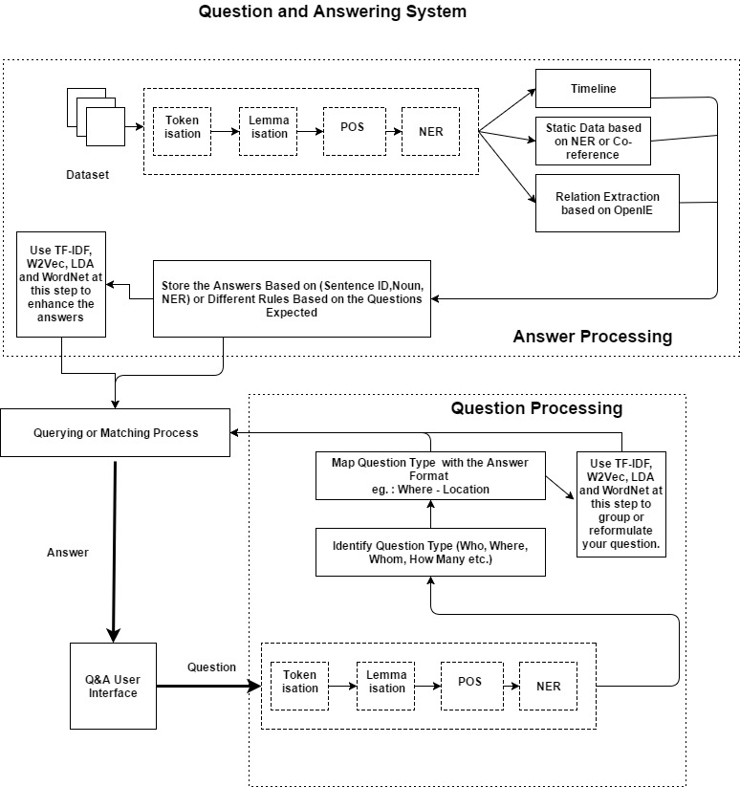
Workflow:

Slide 10
Machine Learning
K-Means Clustering has been used the vectors to predict which cluster it belongs to.
Sample amount of Yahoo Answers Dataset has been used, which involves four different categories
The processing time of it took nearly 71.47 Sec’s
For classification, We used the Naïve bayes and Random Forest with accuracy of 53% and 49%

Slide 11
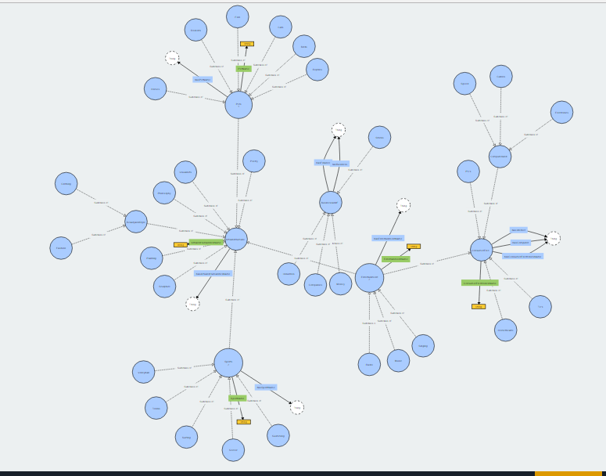
Ontology

Slide 12
Thank you
This work was done in partial fulfillment of the requirements of CS5560:
Knowledge Discovery and Management, CSEE Department, University of Missouri –
Kansas City (Summer 2017).
Instructors: Dr. Yugyung Lee, Mayanka Chandra Shekar,
TAs:
Vijaya Kumari Yeruva,
Saria Goudarzvand.

